Slide 1
M12 Challenge -
Cart Abandonment

Slide 2
The Three Hypotheses
High delivery fees are causing customers to abandon their cart: It is possible that customers are adding items to their cart, but when they see the delivery fees, they abandon their cart. If the delivery fees are too high, it may not be worth it to the customer to complete their purchase.
Poor website design is causing customers to become confused or frustrated: A confusing or cluttered website design can cause customers to become frustrated and leave the site before completing their purchase. If the website is difficult to navigate or items are hard to find, customers may give up and abandon their cart.
The requirement for customers to create an account before completing their purchase is causing them to abandon their cart.

Slide 3
The Three Hypotheses - Reasoning
These assumptions were chosen based on common reasons for high cart abandonment rates in e-commerce. Delivery fees, website design, and requirements for customers to create an account are all factors that can significantly impact a customer's decision to complete their purchase. By addressing these issues, the product team may be able to lower the cart abandonment rate and improve overall customer satisfaction.
I decided to go with the hypothesis on high delivery fees.

Slide 4
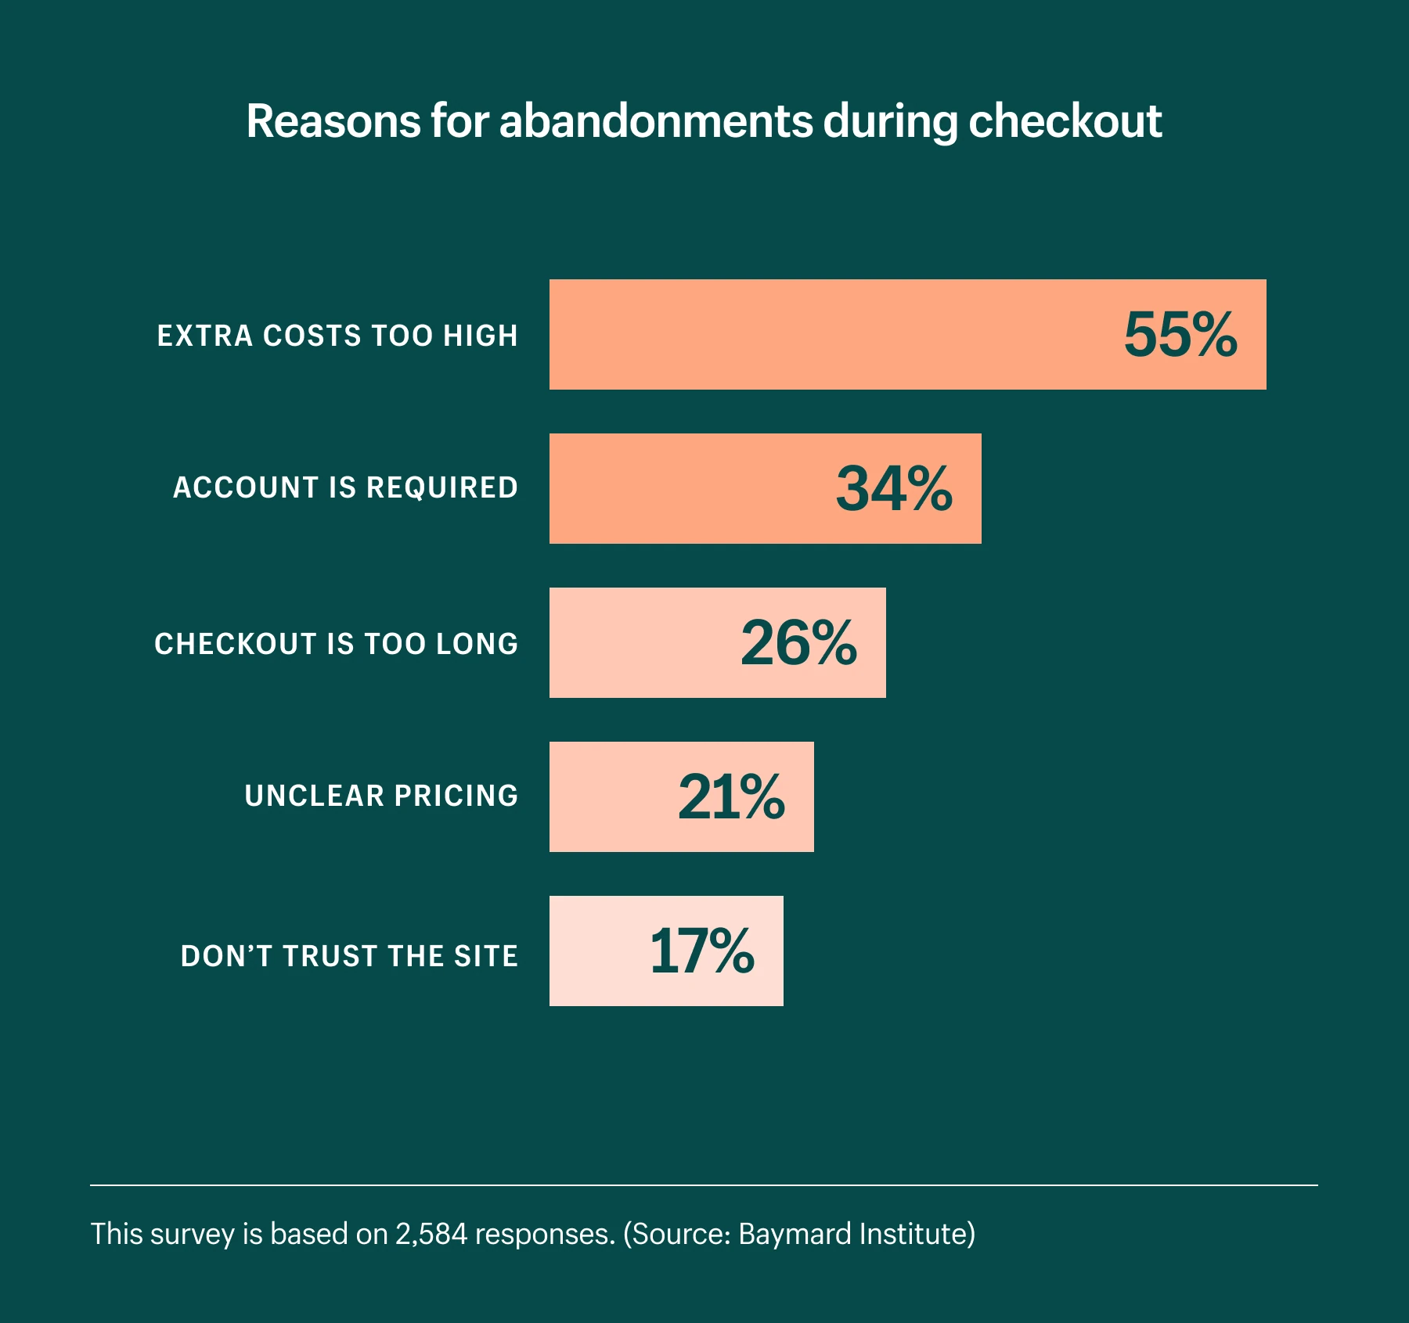
The Chosen Hypothesis Statement
Hypothesis statement: High delivery fees are causing customers to abandon their cart.

Slide 5
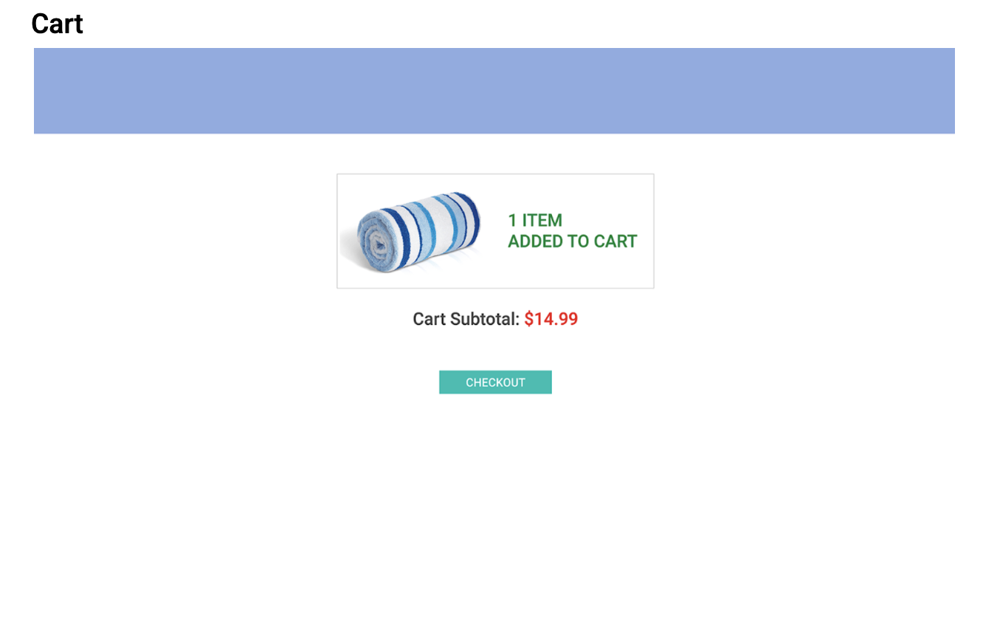
A/B Test
Cart Subtotal: $24.99*
*price includes delivery fee
Get Free Delivery if your order $15 more
ORIGINAL
UPDATED

Slide 6
A/B Test Continued..
Control: The Get It Quick website's current checkout process, including the display of delivery fees.
Variation: In the variation, the delivery fee will be included in the item price, which will be displayed upfront on the product page. Additionally, we are giving them an option for a free delivery if they buy a total of $30+ worth of items. This will give customers a clear idea of the total cost before they add the item to their cart, which may reduce the chances of cart abandonment due to high delivery fees.
Reasoning: I chose to test this variant because high delivery fees were identified as a potential cause for cart abandonment. By including the delivery fee in the item price, customers will have a more transparent view of the total cost of their purchase before they reach the checkout page, which may lead to fewer cart abandonments.

Slide 7
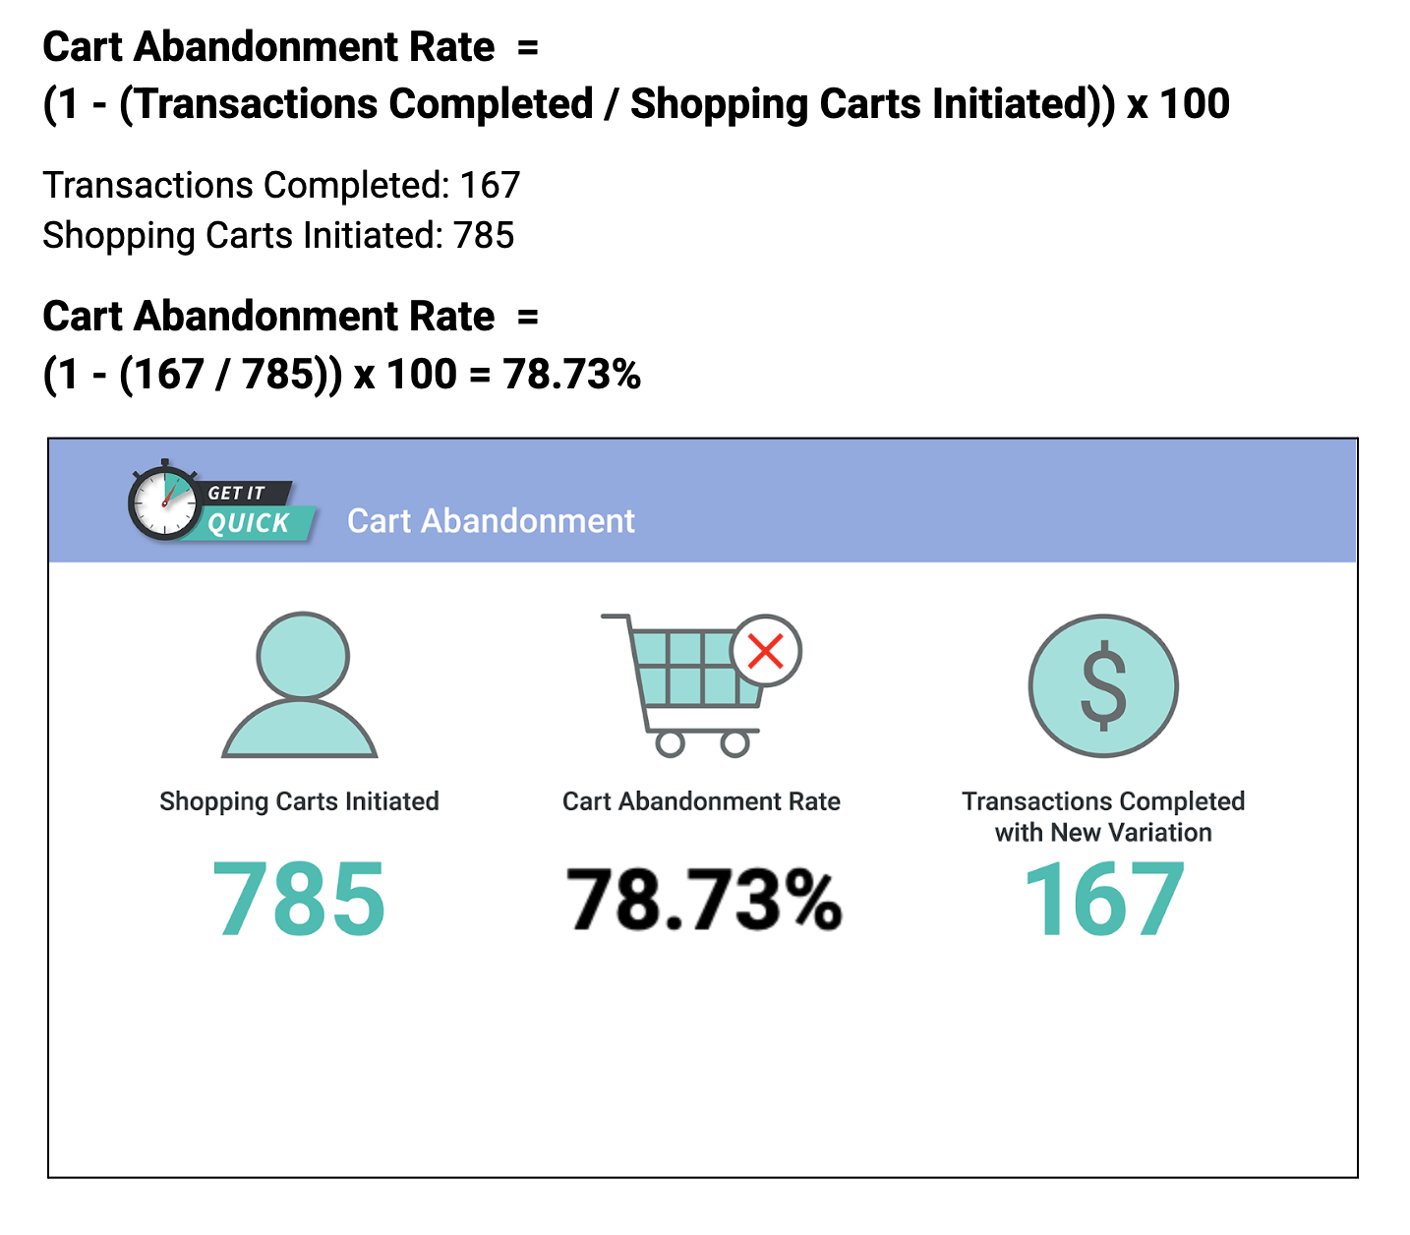
Calculate and Results

Slide 8
Recommendations
Question 1: Did the rate increase, decrease, or remain the same?
Based on the new findings, the abandonment rate increased from the original rate of 76.9% to 78%.
Question 2: List four reasons you think may have caused this new abandonment rate for the variable wireframe.
Confusion caused by including the delivery fee next to the item price: Customers may have been used to seeing the delivery fee as a separate line item and could have become confused by seeing the price increase.
Higher perceived price: By including the delivery fee in the item price, the overall price of the item may have appeared higher to customers, causing them to abandon their cart.
Lack of transparency: Customers may have felt that the company was not being transparent about the true cost of the items, leading to distrust and abandonment.
Inability to compare prices: By including the delivery fee in the item price, customers may not have been able to compare prices across different retailers effectively.

Slide 9
Recommendations
Question 3: If you had more time, what would you do differently, if anything?
Conducting additional user research to understand why customers are abandoning their carts.
Testing different variations that include more transparency around the delivery fee or that show the delivery fee as a separate line item.
Conducting an analysis of competitors to see how they handle delivery fees and determine if there are any best practices that could be adopted.
Improving the website's overall user experience to make it more user-friendly and easier to navigate.
Offering promotions or discounts to encourage customers to complete their purchases.

Slide 10
Recommendations
Question 4: What are your five recommendations to stakeholders, moving forward?
Continue to conduct A/B tests and user research to identify the most effective strategies for reducing cart abandonment.
Consider alternative strategies for reducing cart abandonment, such as offering promotions or improving website design.
Provide more transparency around the delivery fee and overall pricing to build trust with customers.
Emphasize the benefits of using Get It Quick, such as convenience and speed, to encourage customers to complete their purchases.
Regularly review and analyze cart abandonment rates to track progress and identify areas for improvement.

